Slide 1
Please put us first,
Thanks :)

Slide 2
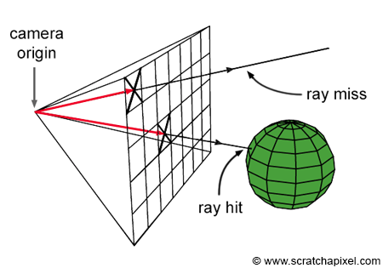
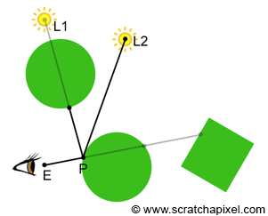
Ray Tracing Through The Graphics Pipeline - GLSL

Slide 3
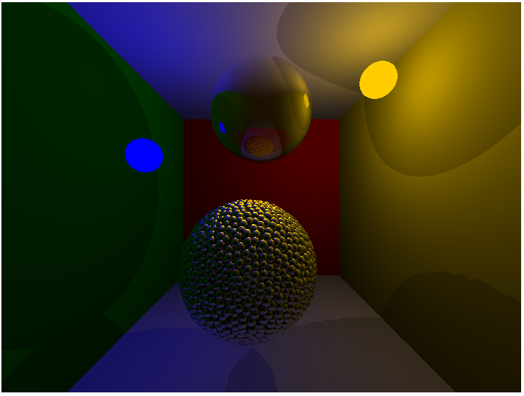
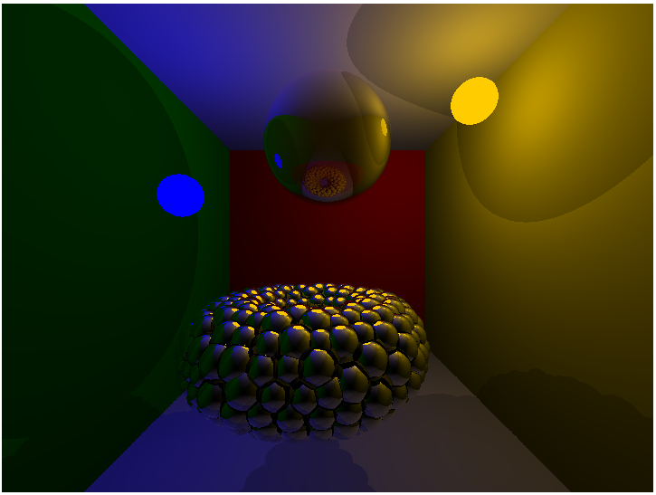
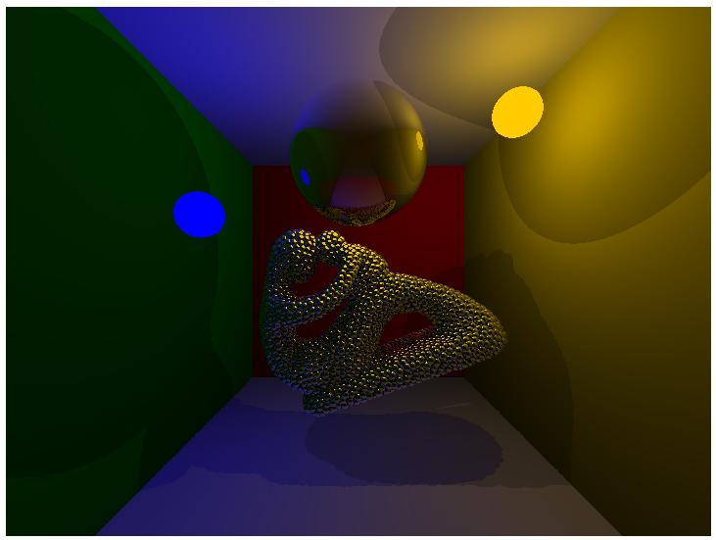
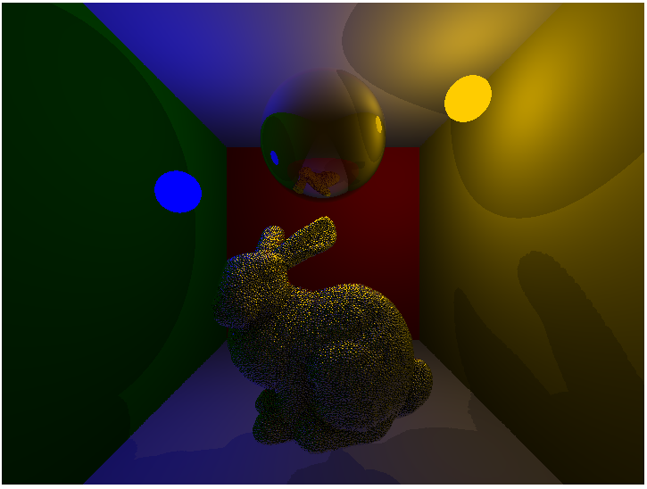
Implementation:
Static scenes + spheres
Limit the recursion depth
Brute force
Memory: Uniform (x) Vs. SSBO (√)

Slide 4
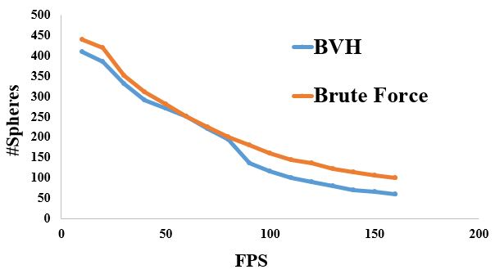
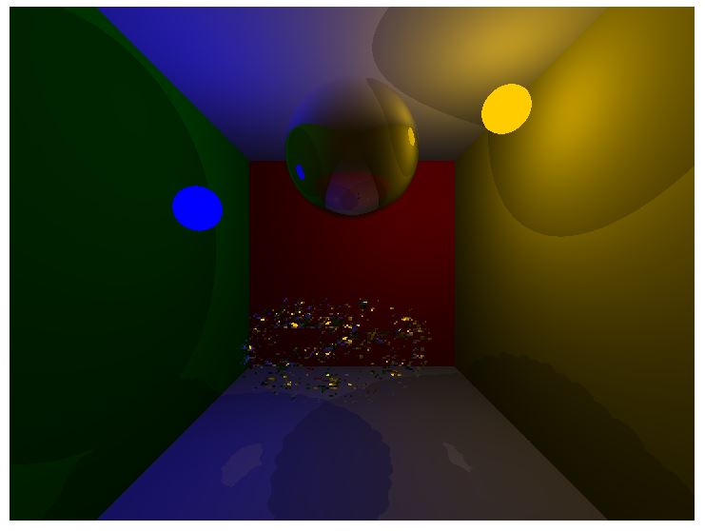
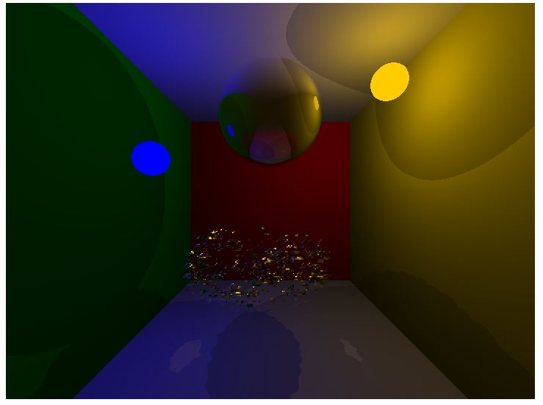
BVH Acceleration:
Local Array
Stack-based traversal
Where/How to keep the stack?
SSBO: Race Condition

